Slide 1
Chapter 12: Mass-Storage Systems

Slide 2
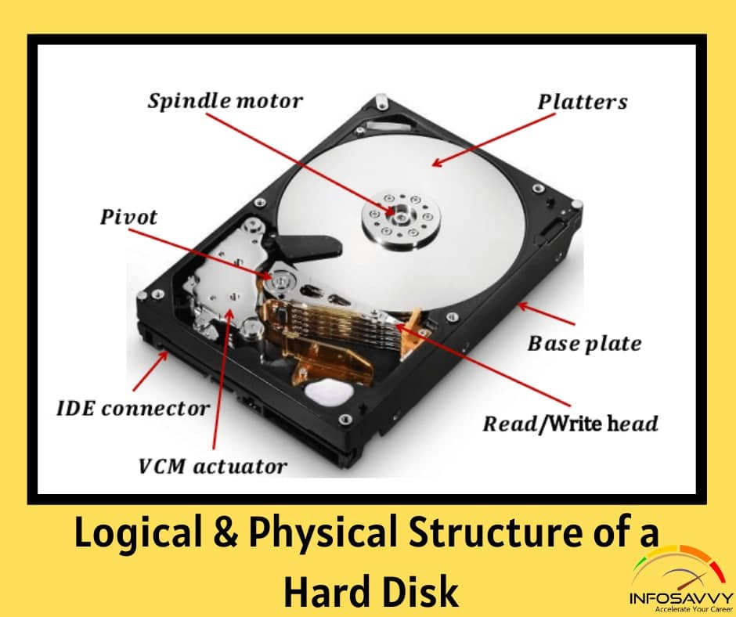
Hard Disk

Slide 3
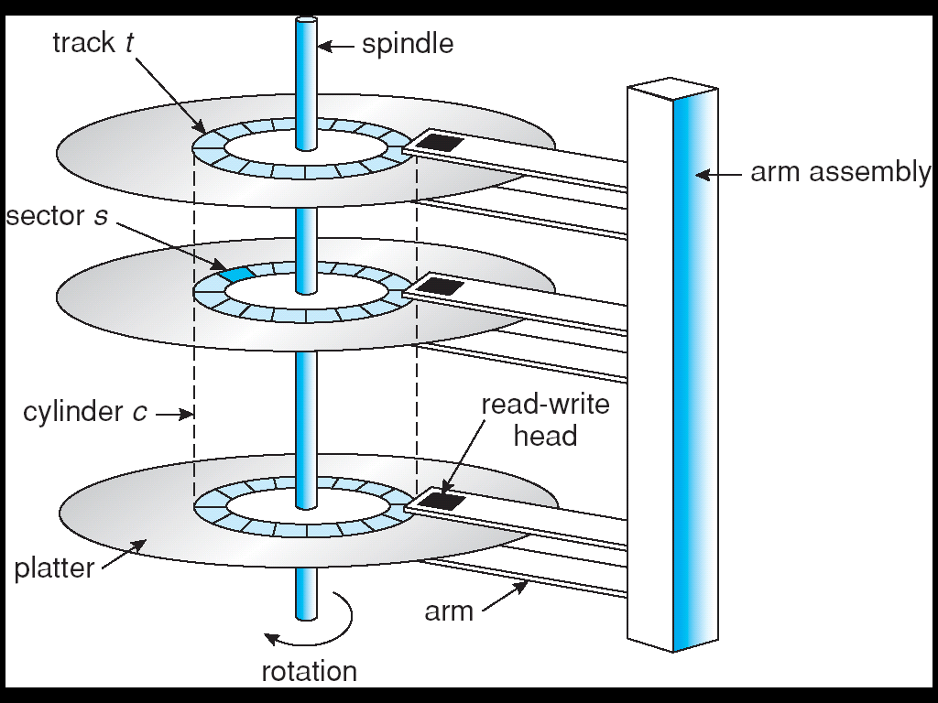
Moving-head Disk Machanism

Slide 4
Overview of Mass Storage Structure (Cont.)
Magnetic tape
  Was early secondary-storage medium
  Relatively permanent and holds large quantities of data
  Access time slow
  Random access ~1000 times slower than disk
  Mainly used for backup, storage of infrequently-used data, transfer medium between systems
  Kept in spool and wound or rewound past read-write head
  Once data under head, transfer rates comparable to disk
  20-200GB typical storage
  Common technologies are 4mm, 8mm, 19mm, LTO-2 and SDLT

Slide 5
Disk Structure
Disk drives are addressed as large 1-dimensional arrays of logical blocks, where the logical block is the smallest unit of transfer.
The 1-dimensional array of logical blocks is mapped into the sectors of the disk sequentially.
  Sector 0 is the first sector of the first track on the outermost cylinder.
  Mapping proceeds in order through that track, then the rest of the tracks in that cylinder, and then through the rest of the cylinders from outermost to innermost.

Slide 6
Disk Scheduling
The operating system is responsible for using hardware efficiently — for the disk drives, this means having a fast access time and disk bandwidth.
Access time has two major components
  Seek time is the time for the disk are to move the heads to the cylinder containing the desired sector.
  Rotational latency is the additional time waiting for the disk to rotate the desired sector to the disk head.
Minimize seek time
Seek time ≈ seek distance
Disk bandwidth is the total number of bytes transferred, divided by the total time between the first request for service and the completion of the last transfer.

Slide 7
Disk Scheduling (Cont.)
Several algorithms exist to schedule the servicing of disk I/O requests.
We illustrate them with a request queue (0-199).
98, 183, 37, 122, 14, 124, 65, 67
Head pointer 53

Slide 8
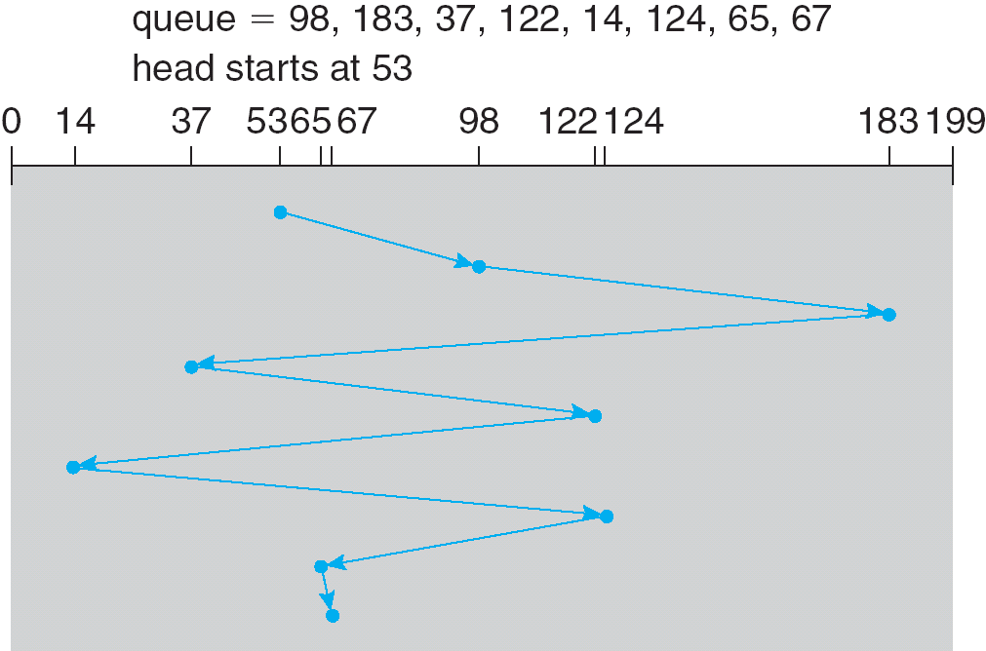
FCFS
Illustration shows total head movement of 640 cylinders.

Slide 9
SSTF
Selects the request with the minimum seek time from the current head position.
SSTF scheduling is a form of SJF scheduling; may cause starvation of some requests.
Illustration shows total head movement of 236 cylinders.

Slide 10
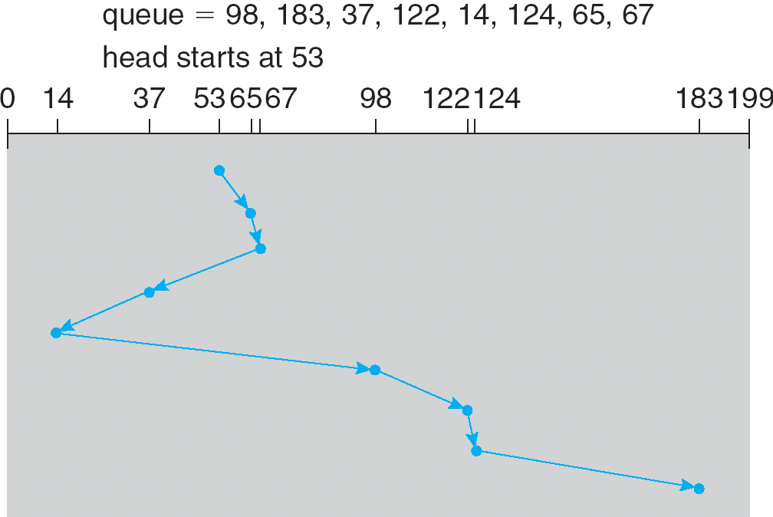
SSTF (Cont.)

Slide 11
SCAN
The disk arm starts at one end of the disk, and moves toward the other end, servicing requests until it gets to the other end of the disk, where the head movement is reversed and servicing continues.
Sometimes called the elevator algorithm.
Illustration shows total head movement of 208 cylinders.

Slide 12
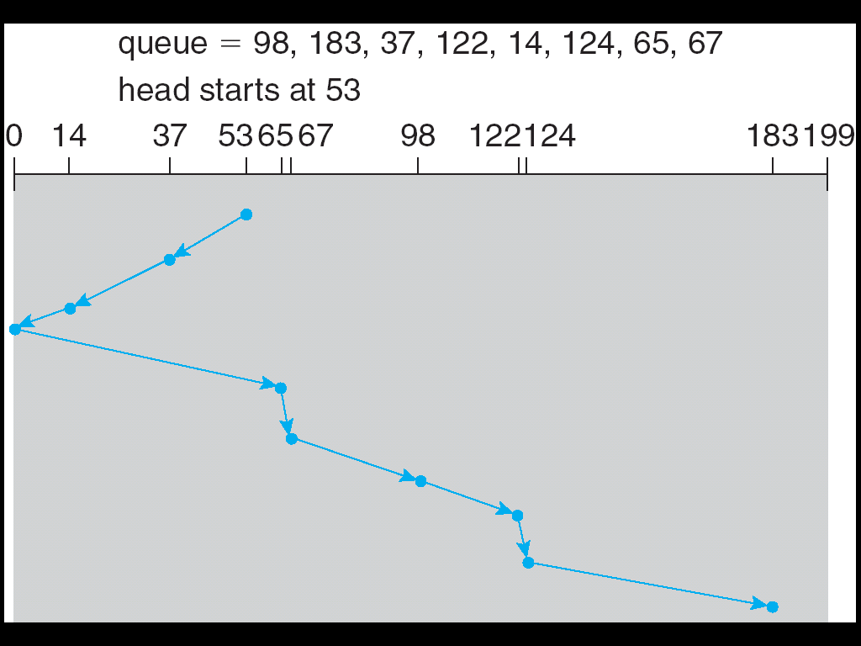
SCAN (Cont.)

Slide 13
C-SCAN
Provides a more uniform wait time than SCAN.
The head moves from one end of the disk to the other. servicing requests as it goes. When it reaches the other end, however, it immediately returns to the beginning of the disk, without servicing any requests on the return trip.
Treats the cylinders as a circular list that wraps around from the last cylinder to the first one.

Slide 14
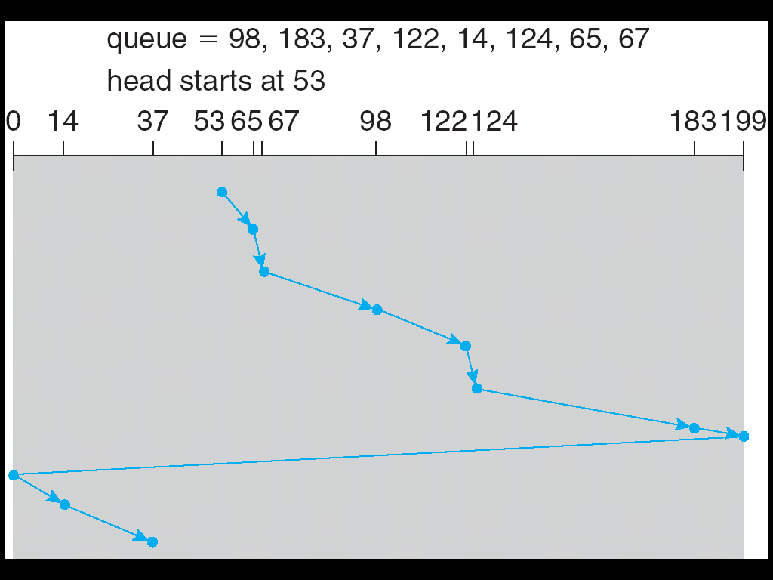
C-SCAN (Cont.)

Slide 15
C-LOOK
Version of C-SCAN
Arm only goes as far as the last request in each direction, then reverses direction immediately, without first going all the way to the end of the disk.

Slide 16
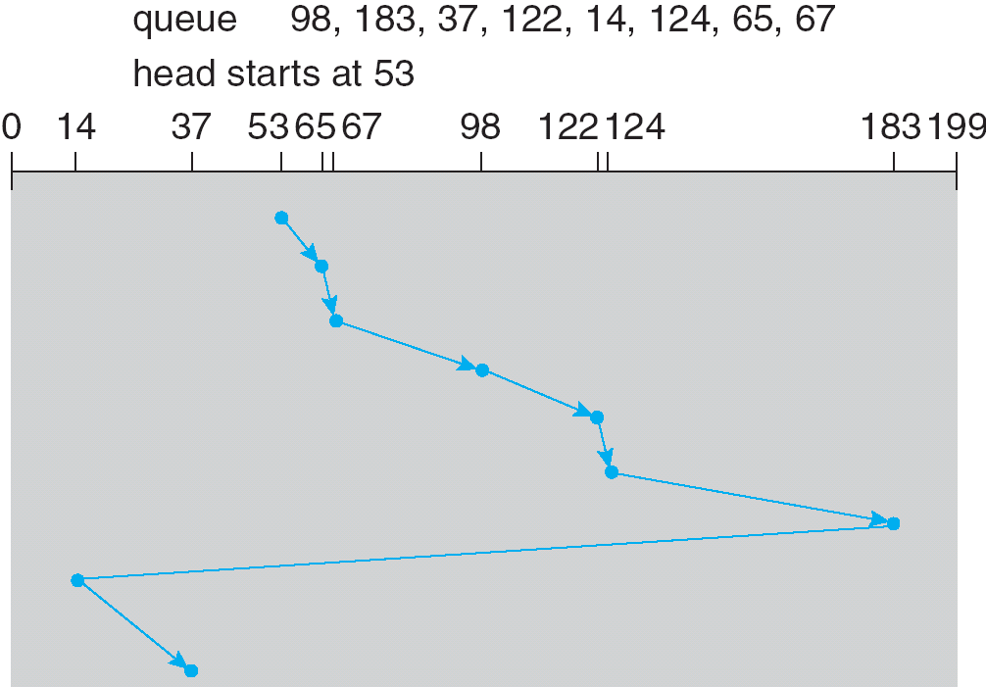
C-LOOK (Cont.)

Slide 17
Selecting a Disk-Scheduling Algorithm
SSTF is common and has a natural appeal
SCAN and C-SCAN perform better for systems that place a heavy load on the disk.
Performance depends on the number and types of requests.
Requests for disk service can be influenced by the file-allocation method.
The disk-scheduling algorithm should be written as a separate module of the operating system, allowing it to be replaced with a different algorithm if necessary.
Either SSTF or LOOK is a reasonable choice for the default algorithm.

Slide 18
RAID Structure
RAID
  Redundant Array of Independent Disk
  Redundant Array of Inexpensive Disk
multiple disk drives provides reliability via redundancy.
RAID is arranged into six different levels.

Slide 19
RAID (cont)
Several improvements in disk-use techniques involve the use of multiple disks working cooperatively.
Disk striping uses a group of disks as one storage unit.
RAID schemes improve performance and improve the reliability of the storage system by storing redundant data.
  Mirroring or shadowing keeps duplicate of each disk.
  Block interleaved parity uses much less redundancy.

Slide 20
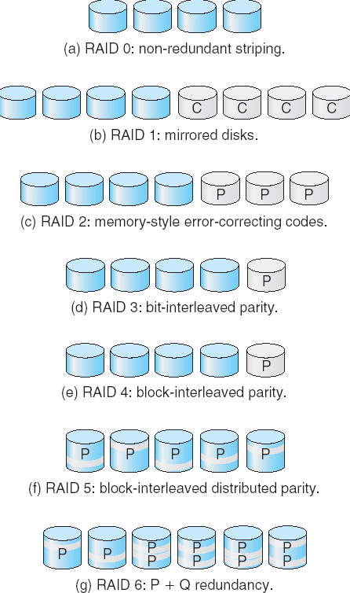
RAID Levels

Slide 21
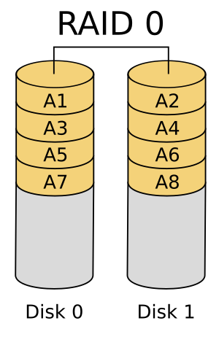
RAID 0 (also known as a stripe set or striped volume) splits ("stripes") data evenly across two or more disks.
A RAID 0 array of n drives provides data read and write transfer rates up to n times as high as the individual drive rates, but with no data redundancy. As a result, RAID 0 is primarily used in applications that require high performance and are able to tolerate lower reliability, such as in scientific computing or gaming.

Slide 22
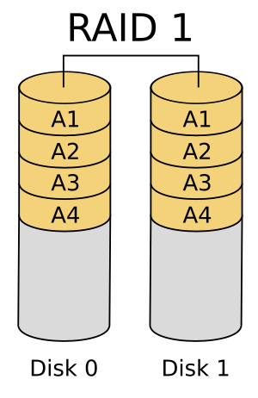
RAID 1 consists of an exact copy (or mirror) of a set of data on two or more disks; a classic RAID 1 mirrored pair contains two disks.
Any read request can be serviced and handled by any drive in the array
while the write performance remains at the level of a single disk

Slide 23
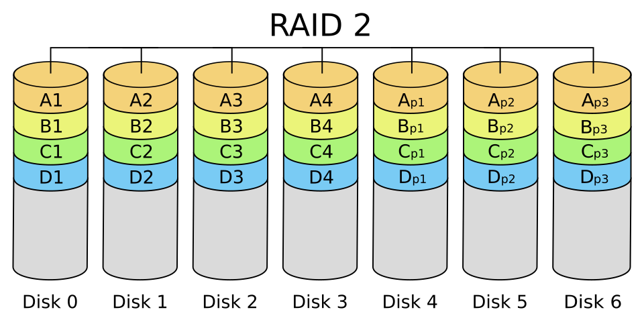
Diagram of a RAID 2 setup. Lowercase p indicates parity bytes.

Slide 24
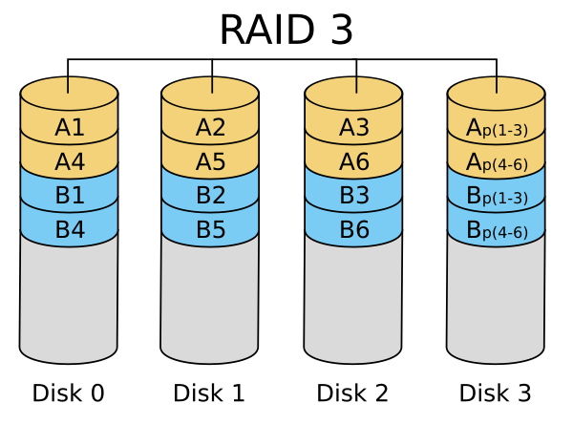
consists of byte-level striping with a dedicated parity disk.

Slide 25
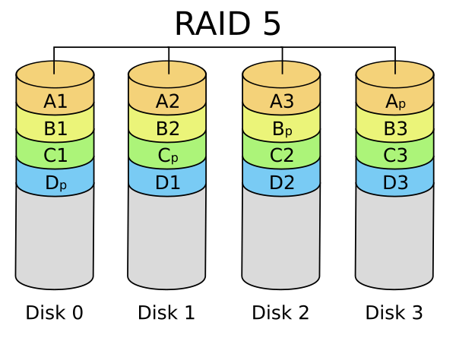
RAID 5 consists of block-level striping with distributed parity. Unlike in RAID 4, parity information is distributed among the drives.

Slide 26
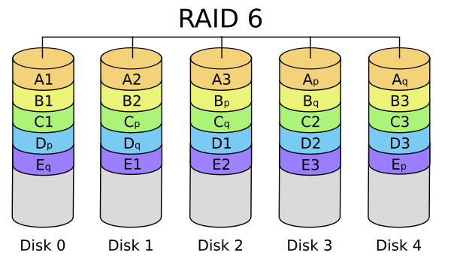
Diagram of a RAID 6 setup, which is identical to RAID 5 other than the addition of a second parity block

Slide 27
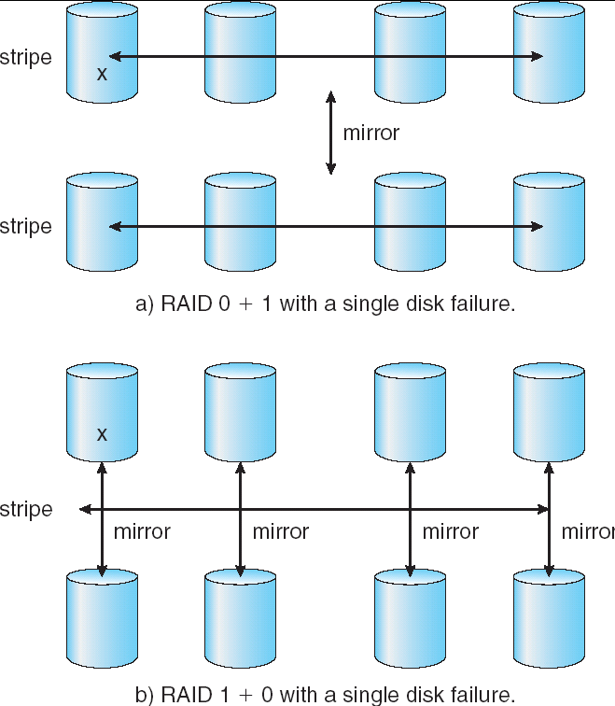
RAID (0 + 1) and (1 + 0)

Slide 28
End of Chapter 12

